Slide 1
Latest update webinar
Covid Test Device Approval
October 2021

Slide 2
Current status
# products
Action
Exempt (technology, contract etc)
Not known
Continue selling
Application submitted
CTDA register
2
Continue selling
Temporary Protocol
46
(32 manufacturers)
Continue selling
Until end Feb 22
Provide more info
Unlisted
100+?
Stop selling
Provide more info
Application closed/failed/withdrawn
0
Stop selling
Reapply (£)

Slide 3
Timelines for next steps
Date
Activity
28th July 2021
Law came into force (contracts)
1st September 2021
Submit applications
End October 2021
Stop placing on the market (unlisted)
End November 2021
Commit to more info (listed and unlisted)
End December 2021
Provide more info (listed and unlisted)
End February 2022
Stop placing on the market (listed)

Slide 4
listed vs unlisted
Temporary listing
Unlisted
“already successfully undergone validation to inform public sector procurement”
Not stated

Slide 5
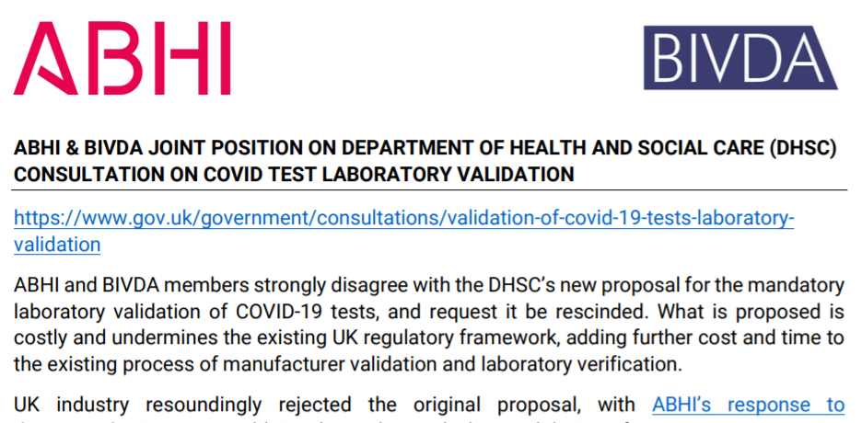
Lab validation
DHS consultation ended 30th September 2021
ABHI and BIVDA joint statement
CTDA update
  60 ish respondents?
  Still working through the responses
  New minister?

