Slide 1
Networks, CDC’s, laboratories and systems South West NHSE&I
BIVDA - May 2022
Bruce Daniel, Head of Pathology, SW NHSE&I

Slide 2
South West Pathology
15 pathology services
Blood sciences and immunology
Clinical microbiology/virology and AMR
Cellular pathology (plus genomics)
Blood transfusion
Point of care testing
“Digital” – interfaces, integration, requesting, LIMS, BI, data and dashboards
Workforce
Networks
GIRFT/effectiveness/PQAD
CDC’s

Slide 3
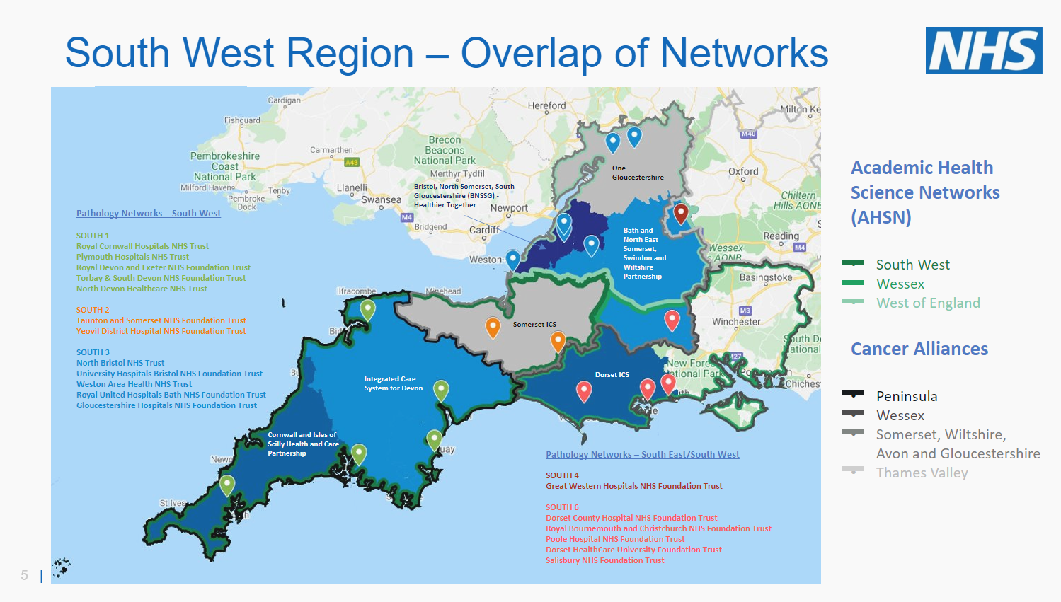

Slide 4
Networks and maturity matrix
Pathology networks are collaborations between multiple NHS provider organisations, and their scale is such that they can be significant operating businesses in their own right. To ensure that these partnerships are enduring and successful, a defined structure for both collaboration and governance (and in thriving networks, ownership) and operation of the pathology network is essential
29 networks (aim to reduce)
Operational planning guidance 22/23 notes mature status target by 24/25
7 domains in maturity matrix
Operational domain includes POCT
Specific “shared supply chain” domain

Slide 7
Procurement
The official line is that NHS pathology services should only be using Category towers.
National team will be working with NHSEI commercial and the category tower to re-state strategy, having engaged with BIVDA
Procurement is a key feature of network maturity development
Expectation that network work plans include improving network procurement

Slide 9
CDC’s
The current x4 aims are to:
Deliver at least one CDC per system
Support diagnostic elective recovery
Improve efficiency and patient experience
Address health inequalities and improve access to diagnostics
Hubs and spokes
Small, standard and large
New build or existing locations
POCT and phlebotomy
Work with the IS ?

Slide 10
Pathways

Slide 11
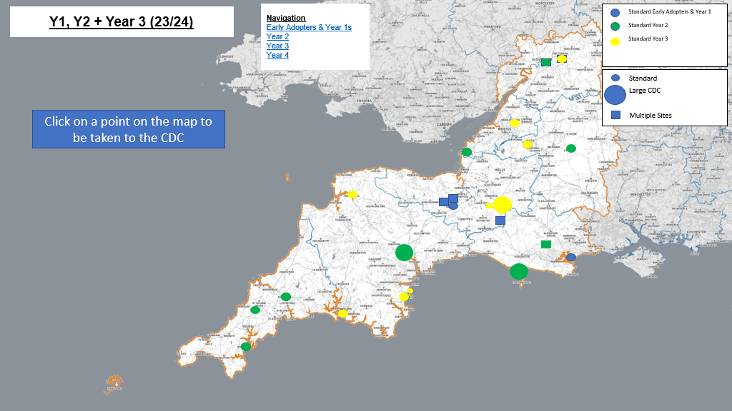

Slide 12
Regional workstreams for Pathology
Network development – planning guidance for 22/23 notes need to be maturing by 24/25
Workforce – R&R, skill mix, apprentices, CPD, secondments, training and development
POCT – governance, use cases, benefit/outcome,
Digital roadmaps and digital histopathology
Data – Model Hospital, PQAD and “performance”
Pathways
Likely new workstreams soon:
AMR
Blood transfusion
Business continuity
Plus, elective recovery, cancer and UEC improvements generally

Slide 13
Return to BAU
Changes to covid use cases, testing regimes and technology and funding thru Summer 2022
Focus on network workplans development
Focus on workforce
Integration and externalising pathology into system/s wide diagnostics
Key theme is horizontal digital integration within between and across systems
Support LTP
Deliver Richards report (“120%”)
Delivery of GIRFT outcomes
More focus on patient pathway benefits

