Slide 1
CTDA webinar to industry Professor Dame Sue Hill - Chief Scientific Officer for England 21 March 2022

Slide 2
Welcome – Professor Dame Sue Hill
Why the regulation was introduced
Experience to date on implementation
What we would like to achieve in this event:
Reflecting on the challenges for industry and the CTDA team
Appreciating the effort that everyone is making, and why it is required
Feeding back suggestions for improvements
Looking ahead, what changes might be required?
Professor Dame Sue Hill is the Chief Scientific Officer (CSO) for England and has been working in NHS Test and Trace/ Testing Operations as part of her cross health and care system role since February 2020. As CSO for England, Dame Sue is the head of profession for the healthcare science workforce in the NHS and associated bodies.

Slide 3
Introduction – Laura Fellowes
The Coronavirus Test Device Approvals (CTDA) Regulation came into effect 28 July 2021.
Manufacturers/distributors wanting to place tests for COVID-19 on the UK market must apply to the CTDA team for approval and pay a charge for validation.
Purpose: To ensure tests available to consumers direct or through testing service providers meet desired performance thresholds for sensitivity and specificity
Manufacturer obligations: Must apply for approval (and pay up to £14,000 on application) providing evidence on the performance of their test, the evidence must meet the requirements set out in guidance provided online
Effect: CTDA approval is required in addition to a CE mark (or EUA/UKCA mark) in order to put a test on the market. Tests without CTDA approval must be taken off the market. This is being enforced by MHRA.
Validation methodology: Evidence is reviewed by UKHSA Scientific Advisers. If sufficient to demonstrate the required performance, the device is added to an online register of approved tests
Technology in scope: CTDA applies to all molecular diagnostic or antigen tests, irrespective of the detection technology used e.g., PCR, LFD, LAMP, POC antigen
(Currently, tests that rely on host response, e.g., the measurement of volatile organic compounds in breath or cytokines in blood are out of scope. )
Exemptions: Tests supplied only to DHSC or DAs, as these have been validated to inform procurement decisions. If manufacturers supply DHSC/DAs wish to sell to anyone else, they need to apply for approval.

Slide 4
Challenges with implementation
Short timeframe for manufacturers to prepare applications
Regulations came into effect 28 July 2021
Deadline for applications for products to remain on the market 31 August 2021
Deadline for approvals for products to remain on the market 31 October 2021
The availability of the ‘Declaration of Conformity’ route to CE-marking meant that most manufacturers had not previously submitted evidence of performance for independent review
Most applications did not meet the requirements set out in the desktop review guidance
Rather than fail applications we provided feedback on gaps in evidence and documentation and provided time for manufacturers to respond
High volume of applications and urgency for tests to be approved due to pandemic, at a time of high & competing demand for Scientific Advisor resources
To avoid a supply shortage, a temporary protocol (1st November 2021 – 28 February 2022) was introduced to allow a specific list of tests to remain on the market pending the outcome of their application.
A second protocol was introduced with a list for professional use tests (1 March – 31 May 2022) and self tests (1 March – 31 August 2022)
Tests included in the protocol have previously been through public sector evaluation or verification (so we have some assurance over performance)
Submission of evidence for independent review will become more the norm for regulatory approvals of IVDs in the future, under 3rd party conformity assessment requirements for UKCA marking and IVDR.

Slide 5
CTDA process flow chart
Initial application
Submission of data, documents & payment
Provide outstanding evidence & documentation (respond within 20 working days*)
Provide clarification of any outstanding questions (respond within 20 working days)
1) Administrative Review
Data and documentation completeness
2) Scientific Adviser Review
Highlight data issues and evidence or documentation gaps
3) Scientific Adviser Review
Check whether supplementary evidence & documentation meets requirements
4) Desktop review (Scientific Adviser)
5) Peer review
(Scientific Adviser)
Desktop Review Assurance Group
(For discussion of any issues that require clarification before feedback to applicant)
6) Desktop Review Assurance Group
7) Regulatory Approvals Committee
*Applications for self-tests have until 30 June to provide self-test data
8) Testing Technology Validation Oversight Board

Slide 6
Guidance updates in response to feedback / experience from initial reviews
Relaxing the requirement for low viral load samples – allowing no less than 20% of positive samples with CT>30 rather that no less than 10% with CT 30 – 35 and >35.
Highlighting the requirements for comparator assays – as many applicants used comparators that were not CE-marked or which did not meet our requirements for sensitivity and specificity
Clarification that the performance data sample types must match those in the IFU – self-test/professional use, nasal/nasopharyngeal, etc.
Clarification that positive samples can be drawn from pre-identified COVID-19 cases (a prospective study is not required), that the data set can combine data from different studies but that discordant samples should not be excluded.
Clarification that antigen tests can be any technology that detects viral component(s) such as proteins, lipids or whole virus and include those that require an analyser or reader and those that do not. Examples include lateral flow tests, immunofluorescence, mass spectrometry and microscopy.

Slide 7
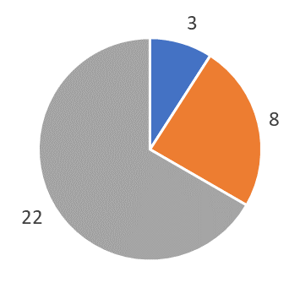
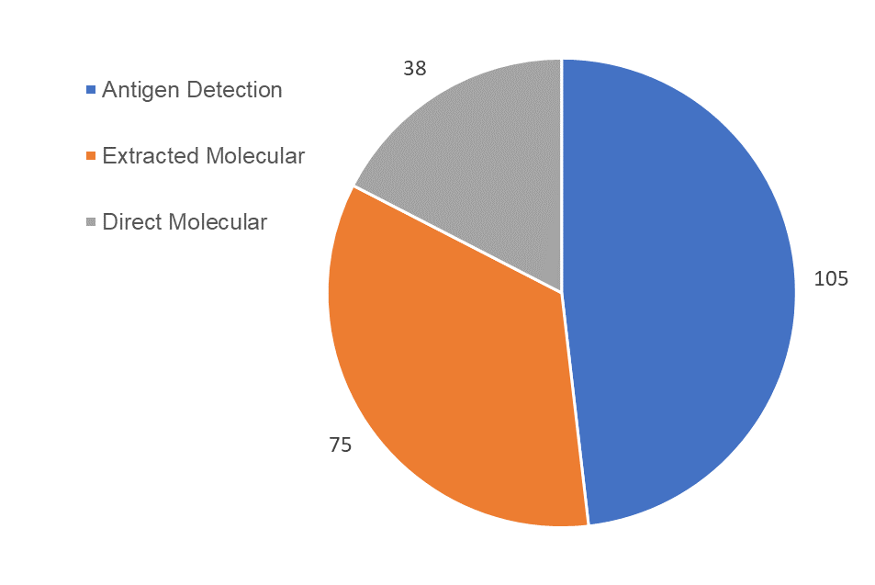
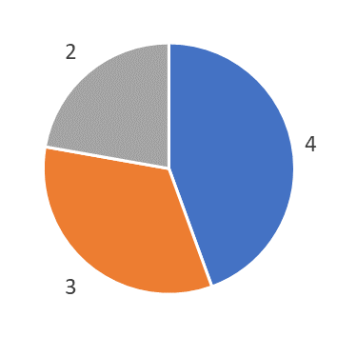
View from scientific advisors – Kerrie Davies
219 applications received as of 14/3/22 – 165 still in progress
167 received before 31/10/21 – 112 still in progress
33 Approved
12 Failed
9 Withdrawn

Slide 8
Why following the guidance is important
Required documents
Regulatory status
Intended use case
Test performance
Biosafety
Method of providing evidence
Test must have appropriate regulatory approval for sale
The data must reflect the use case, otherwise the performance could be incorrect
Comparator assay: a poorly performing comparator can artificially make the applicant's assay look better or worse
If viral inactivation claimed, it must be proved
Sample size: the performance thresholds in the regulations are based on a certain sample size
For example, it is widely known that professional use data will show higher performance than self-test data and that different samples types will produce different levels of performance in a test
For most this can be self-declaration, but for self-test must be via third-party conformity assessment
Correct format; single format speeds up review and removes possibility of errors due from a need to manipulate data
Ensure safety of devices on the market
Viral load spread: the performance thresholds in the regulations are based on data across the full range of viral loads

Slide 9
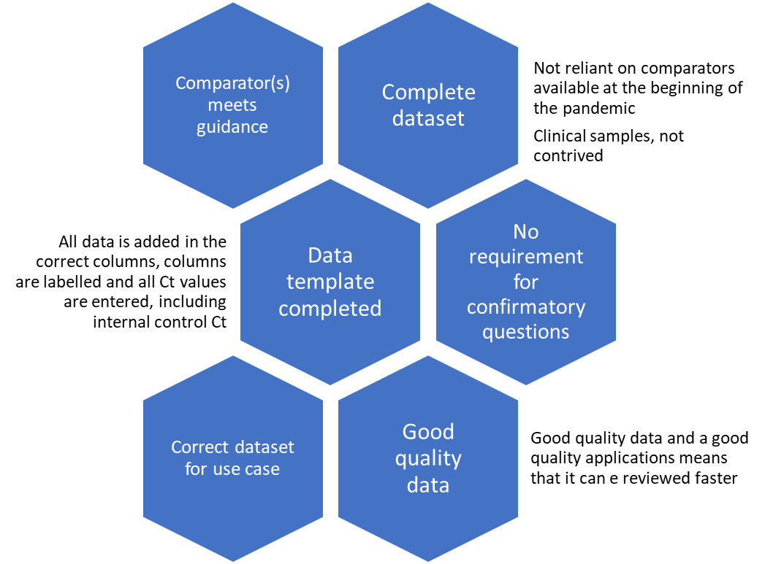
Experience of reviewing submissions
Poor application
Good application

Slide 10
Reasons for unsuccessful results
Failure to meet the application guidance
The data supplied does not cover the requirements of the guidance; e.g., unsuitable comparator, incorrect sample size
This removes tests with poor evidence of performance claims from the market
Failure to meet the performance thresholds within the regulations
The data within the application fails to meet the sensitivity and specificity thresholds within the CTDA regulations
This removes poorly performing tests from the market
Work with applicant to bring application into line with guidance before desktop review.
Provide feedback to the applicant on why their test was not approved, in order that they can reapply with additional or new evidence.

Slide 11
Next steps and close – Sue Hill
Information and contacts - UKHSA
COVID-19 test approval: how to apply - GOV.UK (www.gov.uk)
COVID-19 test approval – step 2: process for desktop review - GOV.UK (www.gov.uk)
COVID-19 test validation approved products - GOV.UK (www.gov.uk)
support@test-validation.test-and-trace.nhs.uk for queries about individual CTDA applications
ctda@dhsc.gov.uk for general queries, concerns or suggestions on implementation of CTDA
from 1 April 2022 this will be ctda@ukhsa.gov.uk
validation@dhsc.gov.uk for broader queries on the policy rationale for CTDA
from 1 April 2022 this will be validation@ukhsa.gov.uk

